Slide 1
Bingham Canyon Landslide - 2013
Group 7 – Cameron Lusvardi & McKay Parkinson

Slide 2
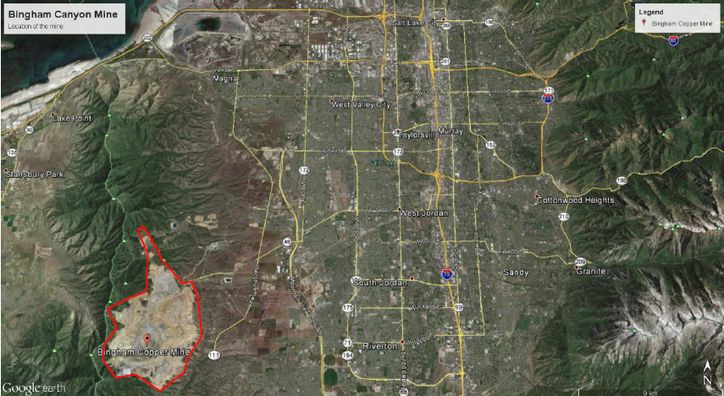
Salt Lake City
Bingham Canyon
Notes:
The Bingham Canyon Mine is one of the largest open-pit mines in the world, measuring more than 4 kilometers (2.5 miles) wide and 1,200 meters (3,900 feet) deep. Located about 30 kilometers (18 miles) southwest of Salt Lake City, Utah, the mine is a major producer of copper, gold, silver, and molybednum.

Slide 3
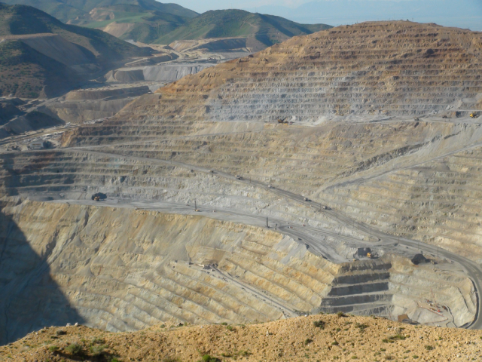
Notes:
The deepest mine in the world
Mining benches carved to make way for equipment
Slopes very steep
Material often dumped
This is a picture of the pit before slope failure.

Slide 4
DUMPED MATERIAL

Slide 5
April 10, 2013
Largest non-volcanic earthquake in North America
2 mass-wasting events
90 minute separation of events
~ 1.9 billion cubic feet
Notes:
On April 10, 2013, two massive landslides carried about 145 million tons of waste rock into the bottom of the open pit at Bingham Canyon, the largest copper mine in the U.S. These are the largest mining-induced landslides in history. The two slides, named the Manefay landslides by Kennecott Utah Copper (KUC), started in the northeast corner of the open pit—the first at 9:30 p.m. was larger (nearly 100 million tons), and the second followed a little over an hour and a half later. Notably, the Manefay slides resulted in no injuries or deaths, but they significantly changed the face of the mine and caused hundreds of millions of dollars of damage to the operation.
The headwall of Bingham’s Manefay slides was 1,150 feet high, and the slide was 9,840 feet long with a total drop of about 2,975 feet. The slides failed mainly along the Manefay series beds at the base of the Upper Pennsylvanian Bingham Mine Formation that dipped moderately northwest into the pit. The slide was somewhat larger than KUC anticipated, but more importantly, instead of acting like a rockfall or slump as previous small pit-wall failures had, this slide acted more fluidly and is properly termed a rock avalanche. This fluidity resulted in the slide reaching speeds in excess of 70 mph and advancing considerably farther to the southwest across the pit bottom than anticipated, resulting in the damage to the equipment.
Initial work after the slides consisted of assessing the situation and developing a plan to stabilize the headwall of the slide so that it would be safe to work below. Because the in-pit crusher and underground ore conveyor were not damaged, ore production resumed just 17 days after the slide. The other priority was to re-establish the main haul road into the pit. The new haul road is about ¾ mile long, 150 feet wide, and required the removal of about 6 million tons of landslide debris. The road was completed in just 7 months, largely as a result of the rapid innovative development and implementation of over 20 pieces of remote-controlled heavy equipment in areas that were still not safe for employees to work.

Slide 6
Radar Prediction
Interferometric Radar
Detected Movement 5 months before
Once movement exceeded 2 in / day all employees evacuated
Notes:
Fortunately, KUC was prepared and had a sophisticated network of geotechnical monitors in place at the mine. These monitors showed instability in the area of the slide beginning in November 2012, but becoming more threatening in early 2013. The area of the slide showed increasing movement, and when it reached a rate of about 2 inches per day on April 10 all employees were evacuated from the mine at 11 a.m. and a press release was issued at 2:38 p.m. warning that a slide was imminent.
While the size of the slide was unexpected, the timing was not. The company that operates the mine had installed an interferometric radar system months before the event that made it possible to detect subtle changes in the stability of the pit’s walls. Signs of increasing strain prompted the mine’s operators to issue a press release seven hours before the collapse, with a warning that a landslide was imminent. All workers were evacuated and production had stopped before the landslide occurred; as a result, no one was injured.

Slide 7
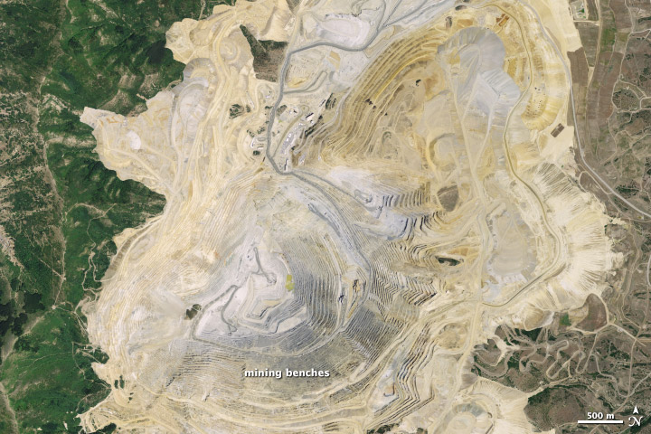
BEFORE
Notes:
Before on July 20, 2011

Slide 8
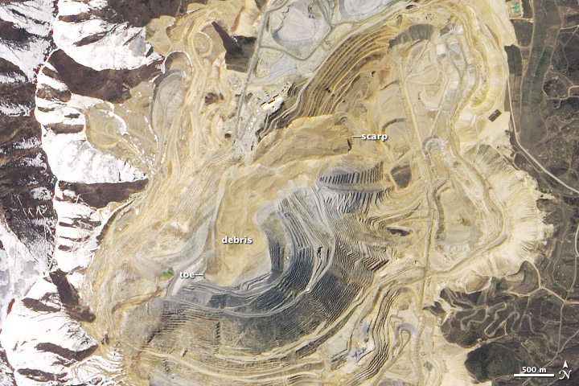
AFTER
Notes:
After on May 2, 2013

Slide 9
BEFORE
Notes:
Before on July 20, 2011

Slide 10
AFTER
Notes:
After on May 2, 2013

Slide 11
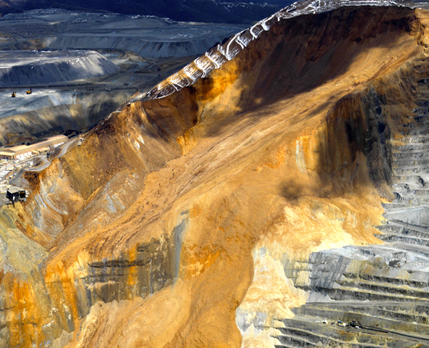

Slide 12
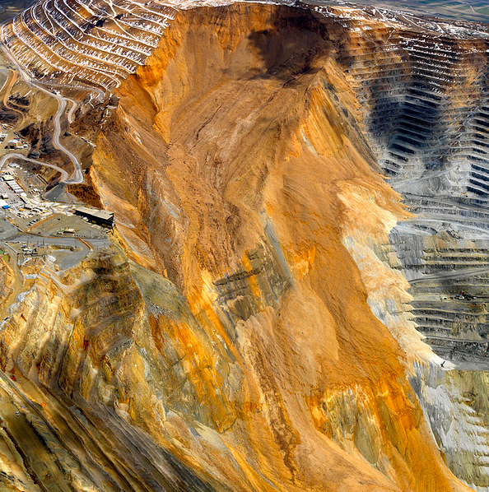

Slide 13
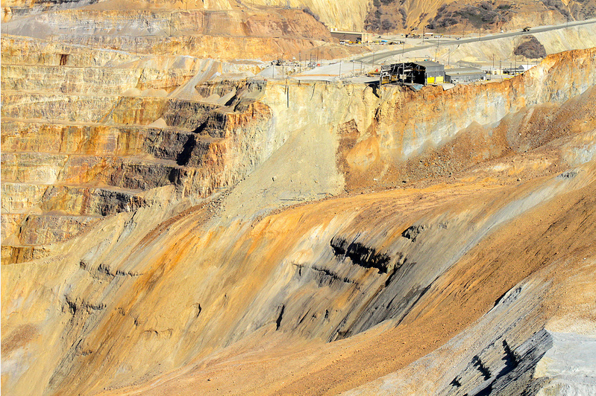

Slide 14
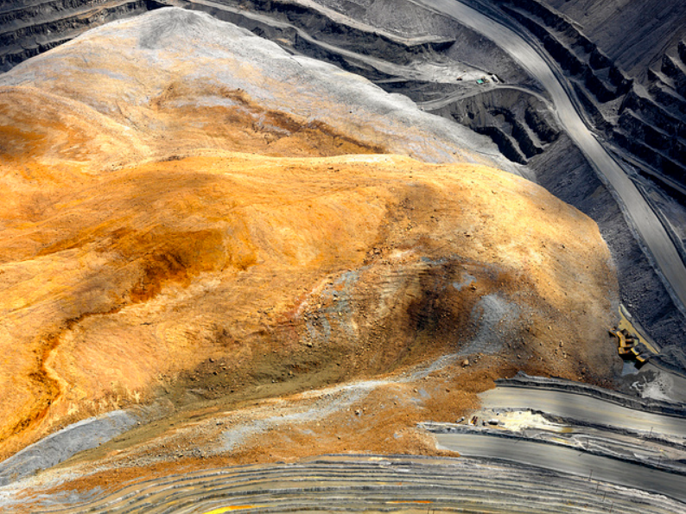

Slide 16
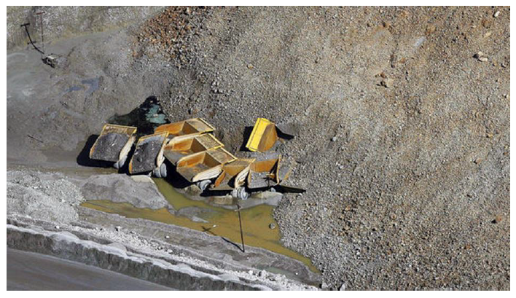
3 Hydraulic Shovels
14 Haul Trucks
Drills, Bulldozers, Graders
1 Truck Costs ≈ $5,000,000
Notes:
Despite the efforts to evacuate, the slides resulted in significant damage to both the mine’s fixed infrastructure, including the main haul road, and somewhat surprisingly, to its fleet of mobile equipment, which had been moved to the far side of the pit. Damage to the fleet included 3 of the 13 shovels, 14 of the 100 haul trucks, and some other ancillary equipment including drills, bulldozers, and graders (haul trucks cost approximately $5 million and shovels about $45 million each). Some of the equipment was recovered, repaired, and returned to service, but most was a total loss.

Slide 17
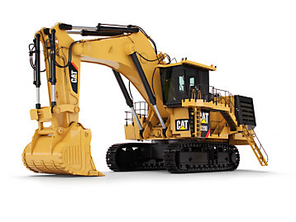
1 Shovel ≈ $45,000,000
Notes:
Despite the efforts to evacuate, the slides resulted in significant damage to both the mine’s fixed infrastructure, including the main haul road, and somewhat surprisingly, to its fleet of mobile equipment, which had been moved to the far side of the pit. Damage to the fleet included 3 of the 13 shovels, 14 of the 100 haul trucks, and some other ancillary equipment including drills, bulldozers, and graders (haul trucks cost approximately $5 million and shovels about $45 million each). Some of the equipment was recovered, repaired, and returned to service, but most was a total loss.

Slide 18
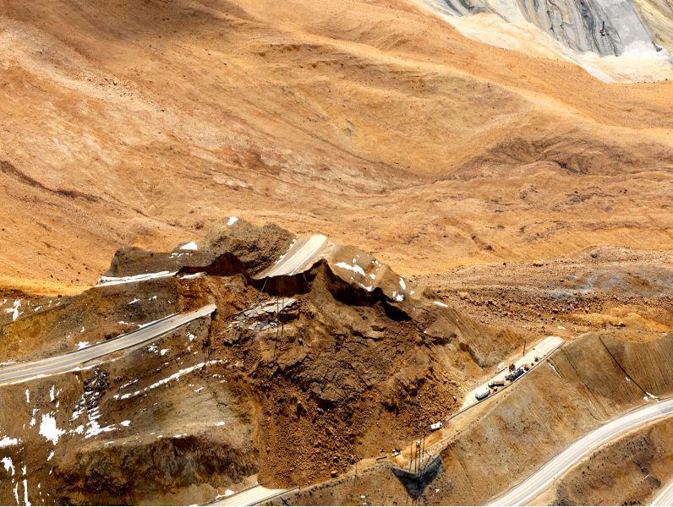
3 year full recovery
Notes:
Remarkably, Bingham continued to produce moderate amounts of ore following the slides in 2013 and 2014, but in 2015 a reappraisal of the overall stability of the east side of the open pit mandated a massive waste rock stripping (removal) program to reduce the pit slopes and the risk of future landslides. This required nearly all of the mine equipment to be used in this waste stripping operation, resulting in little new ore production and the highest stripping ratio (5:1 waste:ore) in the 110- year history of Bingham’s open-pit mining operations. Consequently, most of the material processed through the Copperton concentrator in 2015 was from a large, low-grade stockpile of previously mined material. Copper production from this low-grade material reduced the mine’s output in 2015 by nearly 55 percent from the already modest 2014 production. This made Bingham’s 2015 production the lowest since the mine was closed in 1986 due to low metal prices. Despite these considerable difficulties, Bingham still realized a slight profit in 2015.

Slide 19
Two Landslides
95 minutes apart

Slide 20
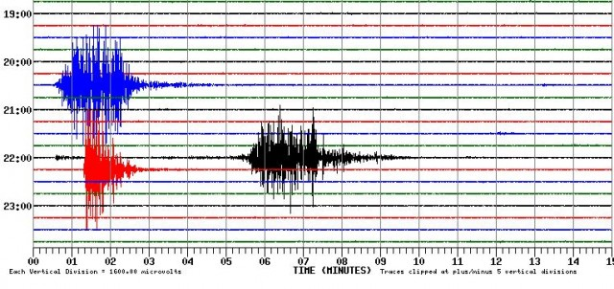
Salt Lake City Granite Mountain Vault Seismic Recording Station
~90 Minutes Apart
Notes:
the landslide is sufficiently large that it was detected on seismic networks. Jeff Moore kindly pointed out that the landslide appears on the University of Utah seismic recording station record from Granite Mountain Vault, Salt Lake City:
First slide in blue
Second slide in black
third
The second slide was followed 11 minutes later by a small, shallow earthquake (about magnitude 2.5) beneath the mine, induced by the rapid shifting weight of the slides.

Slide 21
Salt Lake City Granite Mountain Vault Seismic Recording Station
Notes:
Third event in red:
The second slide was followed 11 minutes later by a small, shallow earthquake (about magnitude 2.5) beneath the mine, induced by the rapid shifting weight of the slides.

Slide 22
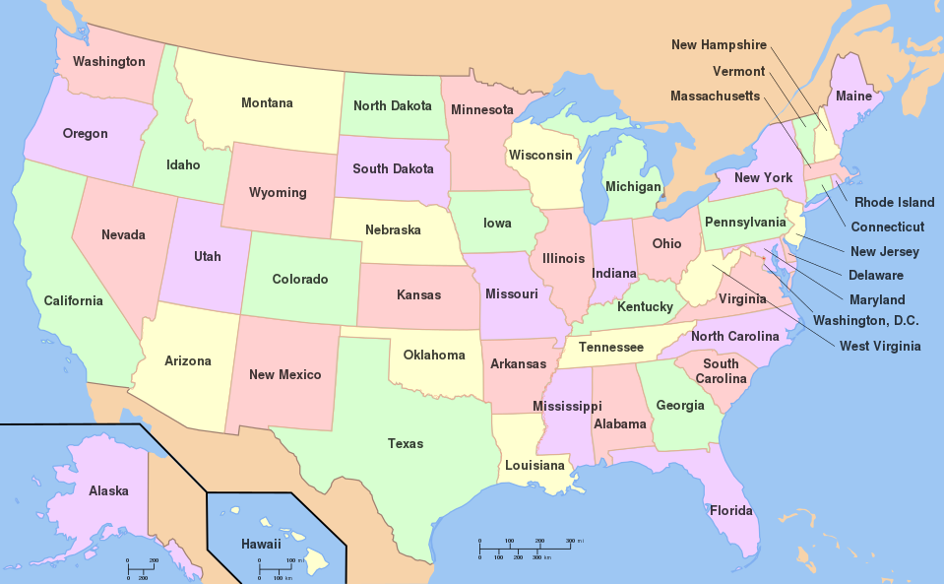
Notes:
Meanwhile, Colin Stark noted that the landslide was recorded on the Columbia University global seismic dataset in New York, which suggests that the volume is in the tens of millions of cubic meters.
Just one that was mentioned maybe even more further away

Slide 23
Slope Stability Analysis

Slide 24
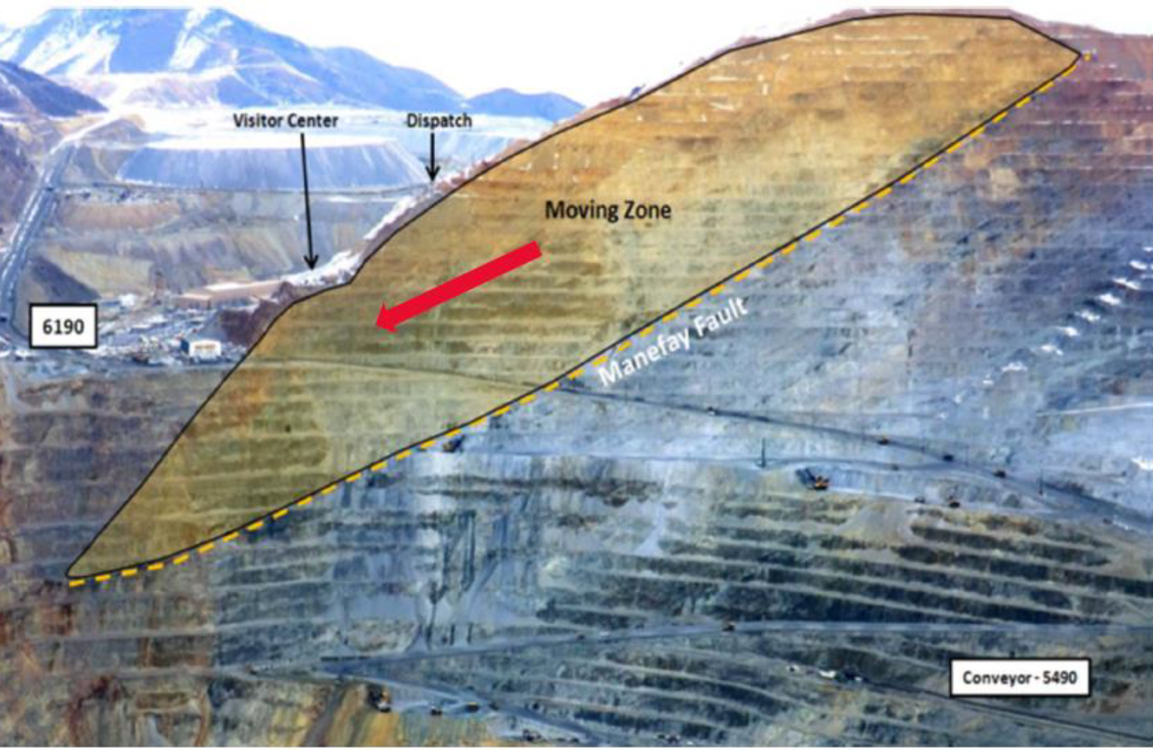
Potential Causes of Failure
Mining operations typically utilize low factors of safety (1.0-1.1)
Spring (Wet) Season
Manafey Fault

Slide 25
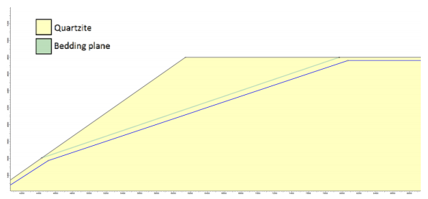
Other Models
2015 Thesis by Willian Niday
Modeled the slope failure along bedding planes

Slide 26
Other Models
2016 Thesis by Alfred Septian
Created a 3D model to analyze the failure
Found that the first slide likely triggered the second

Slide 27
In-Situ Conditions
Parameter | Monzonite | Clay Monzonite | Limestone | Altered Limestone | Quartzite
Cohesion (Mpa) | 1.8 | 0.59 | 2.9 | 1.1 | 0.65
Cohesion (psf) | 37593 | 12322.15 | 60566.5 | 22973.5 | 13575.25
Friction Angle | 37 | 35 | 40 | 32 | 35
Density (t/m^3) | 2.88 | 2.64 | 2.8 | 2.78 | 2.6
Density (pcf) | 179.712 | 164.736 | 174.72 | 173.472 | 162.24

Slide 28
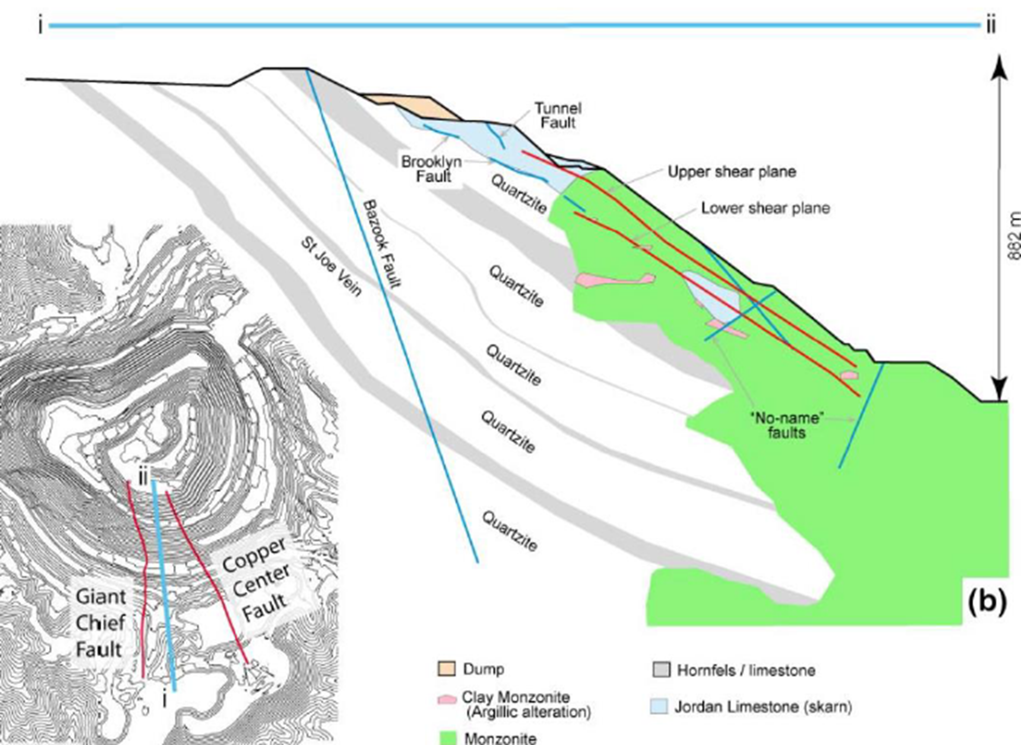

Slide 29
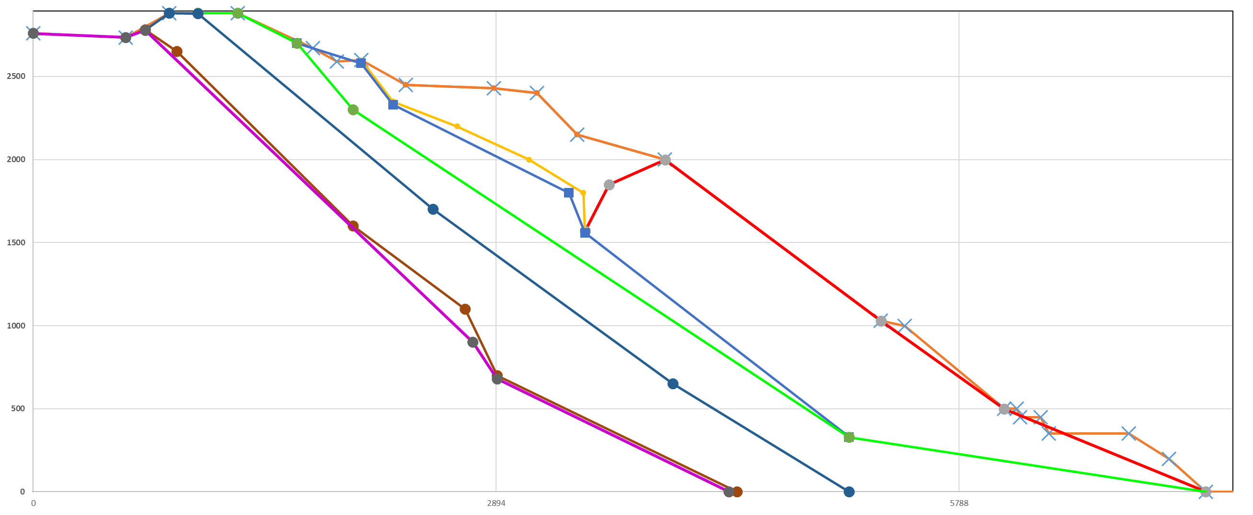

Slide 31
Notes:
Used these overlaid points

Slide 32
Parameter | Monzonite | Clay Monzonite | Limestone | Altered Limestone | Quartzite
Cohesion (Mpa) | 1.8 | 0.59 | 2.9 | 1.1 | 0.65
Cohesion (psf) | 37593 | 12322.15 | 60566.5 | 22973.5 | 13575.25
Friction Angle | 37 | 35 | 40 | 32 | 35
Density (t/m^3) | 2.88 | 2.64 | 2.8 | 2.78 | 2.6
Density (pcf) | 179.712 | 164.736 | 174.72 | 173.472 | 162.24
Notes:
Used soil properties

Slide 33
Notes:
Used the 3d analysis to determine where the circles should be

Slide 34
Notes:
Used the 3d analysis to determine where the circles should be

Slide 35
Notes:
Used the 3d analysis to determine where the circles should be

Slide 36
UTEXAS ED 4

Slide 37
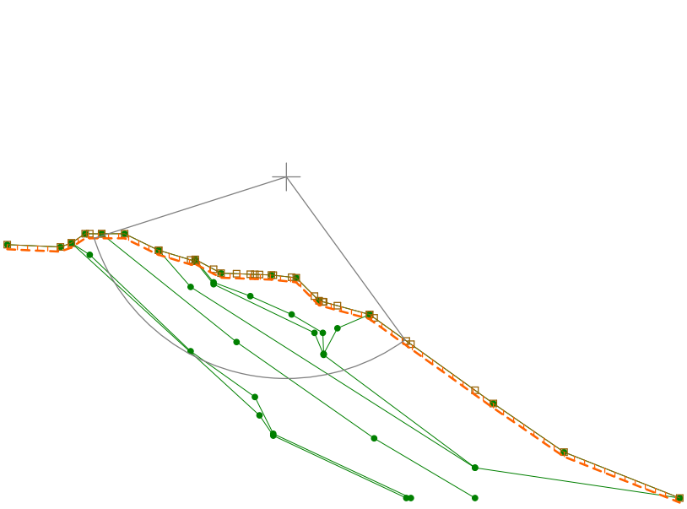
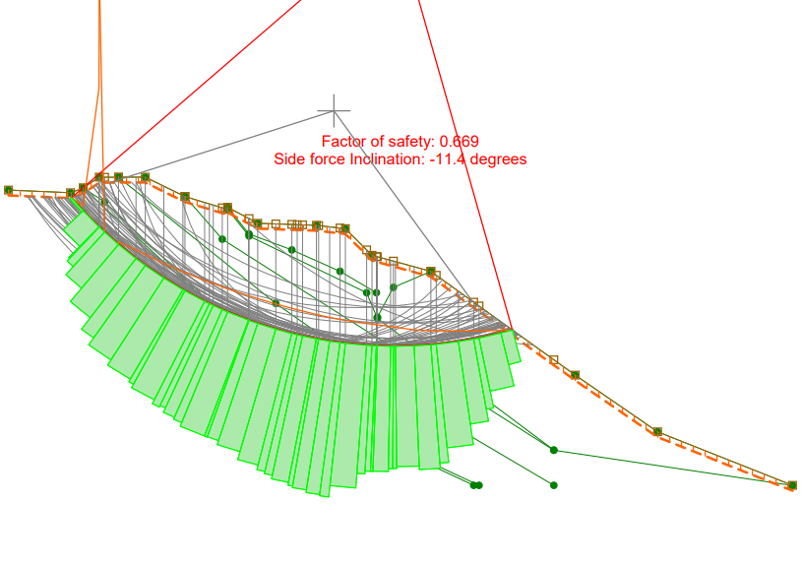

Slide 39
0.7

Slide 43
0.7

Slide 44
http://fox13now.com/2015/04/16/kennecott-still-cleaning-up-debris-2-years-after-massive-landslide-at-bingham-canyon-mine/

